Slide 1



Slide 2
My name is Indu ….
Your turn! In under one-minute:
Your Name and Course!
Show of hands:
Experience in Data Visualization using any tool?
Experience in Tableau?
How many of you have downloaded Tableau?

Slide 3

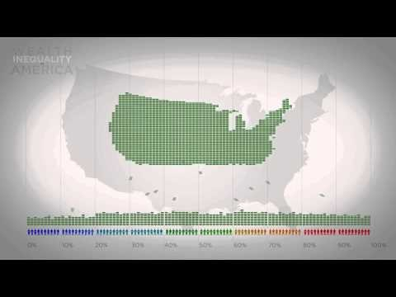
Visualization (storytelling with data)
The Beauty of Data Visualization
Wealth Inequality in America

Slide 4
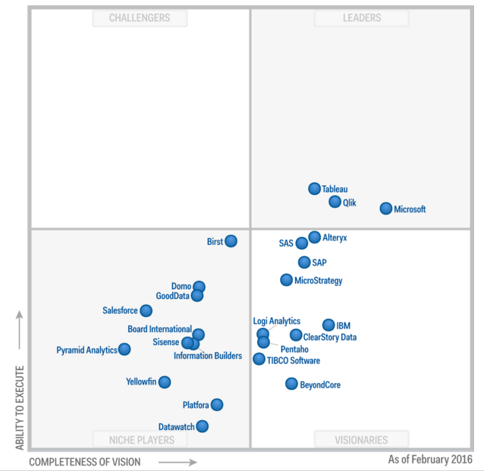
- Introduction
Gartner Magic Quadrant for BI and Analytics Platform
Notes:
For the fourth year, Tableau is a leader in the Magic Quadrant for Business Intelligence and Analytics Platforms Report.
Tableau is business intelligence software that allows anyone to easily connect to data, then visualize and create interactive, sharable dashboards.

Slide 5
What will we cover today in Tableau?
Tableau Interface
Connecting to data
Drill Down and Hierarchies
Sorting
Grouping
Ways to Filter
Quick filters

Slide 6
Drill Down and Hierarchies
Drill Down to Data (Two Ways)
Building Hierarchies (Category-Sub Category)
Working with Hierarchies
Date Hierarchies (Order Date)

Slide 7
Sorting
Quick Sort on the axis (Asc-Desc-Clear)
Sorting by using Tool Bar Button
Sorting from the Pill
Clear Sorts

Slide 8
Grouping
Grouping from the Header
Grouping from the Data Window
Include Other
Using a Grouped Field
Grouping Marks – Visual Grouping

Slide 9
Ways to Filter
Like the “WHERE” clause in SQL.
We can drag a field, such as Category, to the filter shelf directly,
We can use a quick filter by right clicking on the field
Using keep only or exclude
Removing Filters

Slide 10
Quick filters
By selecting “Show Quick Filter”.
Quick filters can be applied across specific worksheets, or even all using that data source.
We can even add an “apply button”
The title can be toggled on/off or edited
Layout Mode for Quick Filters -discrete fields and continuous field.

Slide 11

